Slide 1
Information Security Risk & Compliance (ISRC)
StackHawk at Bayview
Henry Post - May 2026

Slide 2

Meta slide
Who are you?
  Nice to meet you! I’m Henry Post. I lead AppSec and I’ve been at Bayview for 3 years, US Bank for 4 years previously. I love baking, cooking, fighting games, gardening, weightlifting, and am currently studying for the OSCP exam (hacking exam). I specialize in Application Security and penetration testing. My personal site is https://drakonix.systems/ if you’re curious about other projects I’ve worked on. I host some infra there for animal shelters.
How did you generate your diagrams?
  I use Mermaid to generate diagrams. If I could, I would use LaTeX or pure Markdown plus pandoc CLI for deterministic formatting for this entire PPTX.
    https://github.com/Mermaid-Chart/vscode-mermaid-chart
Are there guides related to AppSec?
  Yes! There are many below.
    https://bayview0.sharepoint.com/sites/ApplicationSecurity

Slide 3
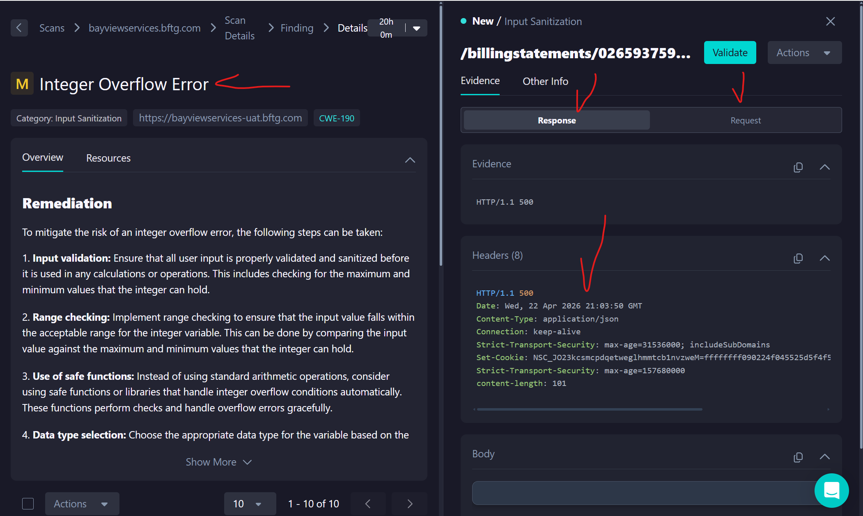
What is StackHawk? 1
In its simplest description, it’s a tool that sends malicious HTTP requests and detects then summarizes vulnerabilities. Dev POV: Setup YAML, run scan, get scan results

Slide 4
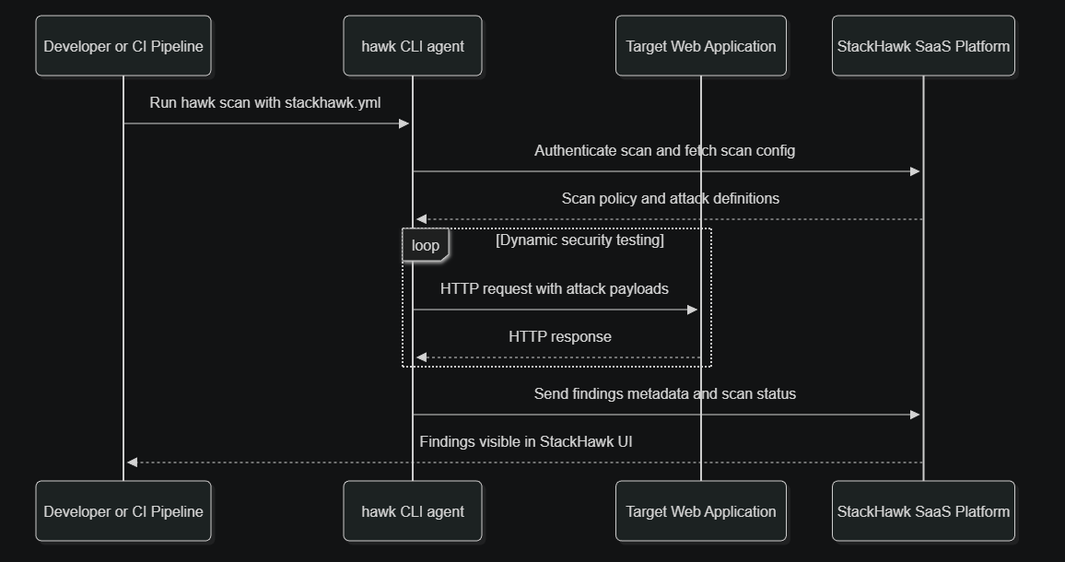
What is StackHawk? 2
In its simplest description, it’s a tool that sends malicious HTTP requests and detects then summarizes vulnerabilities. Dev POV: Setup YAML, run scan, get scan results

Slide 5
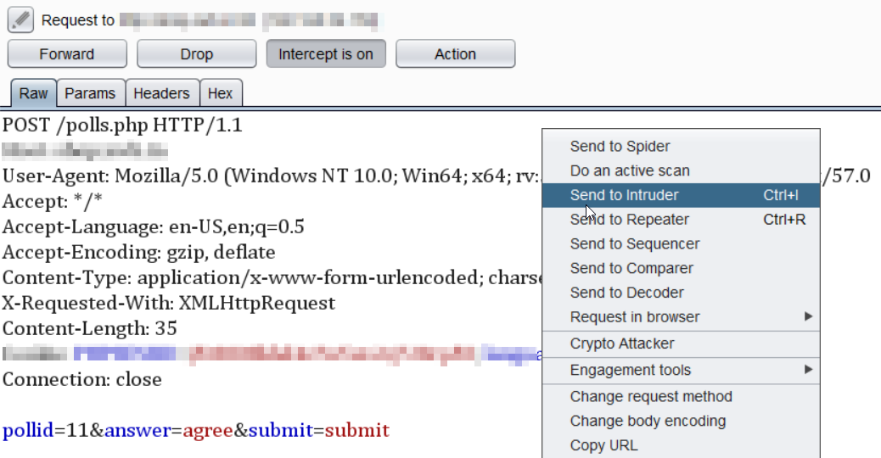
What ISN’T StackHawk?
StackHawk doesn’t scan source code!
  It can ingest OpenAPI spec to enhance scans,
  And can do authenticated scans.
  Reducing it a bit; you can think of it as “Burp Suite but with more steps and a web UI”.
    (Burp Suite is an HTTP request tamper tool.)
    StackHawk is highly automated, has a big catalogue of HTTP-request-based tests.
StackHawk isn’t magic. It has noise like any tool, and needs tuning.
  This can be done with “Technology Flags”
  Noise is also greatly reduced if we do authenticated scans.
  Adding an OpenAPI Spec also reduces noise.

Slide 6
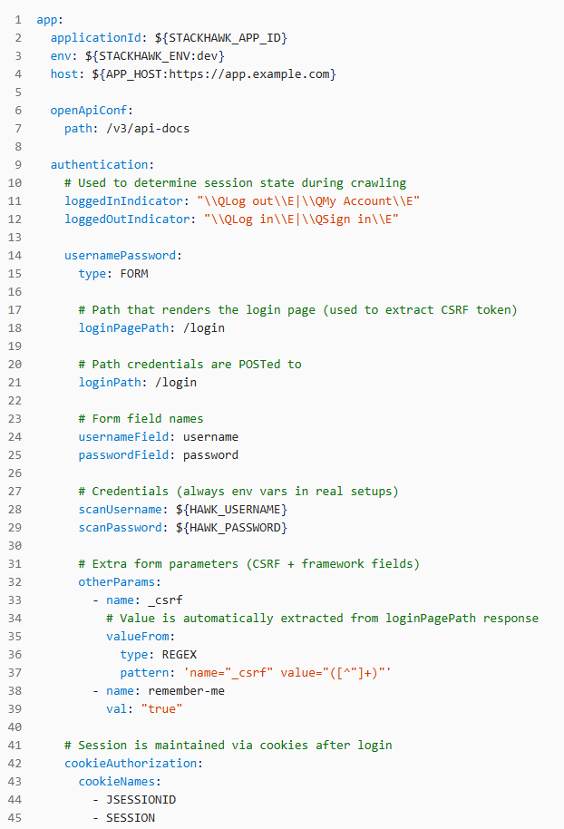
Okay, how do we use StackHawk?
It’s quite simple. We need:
  A URL to scan
  (Highly preferred) Login credentials
  (Preferred) an OpenAPI spec
  A StackHawk .yml config file (should be committed to Git)
Problem: Historical integration
  Back in 2025, I tried to get dev teams to integrate with StackHawk. This failed! Not due to the dev teams, nor a shortcoming of the tool. The nature of StackHawk’s auth requires dev teams to fully re-describe their auth flow, which is a lot of effort.
Solution: New auth flow
  There is a new StackHawk feature called “Flight Path”, that I will go into on the next slide. It removes the need for devs to write 50+ LOC (lines of code) of YAML.

Slide 7
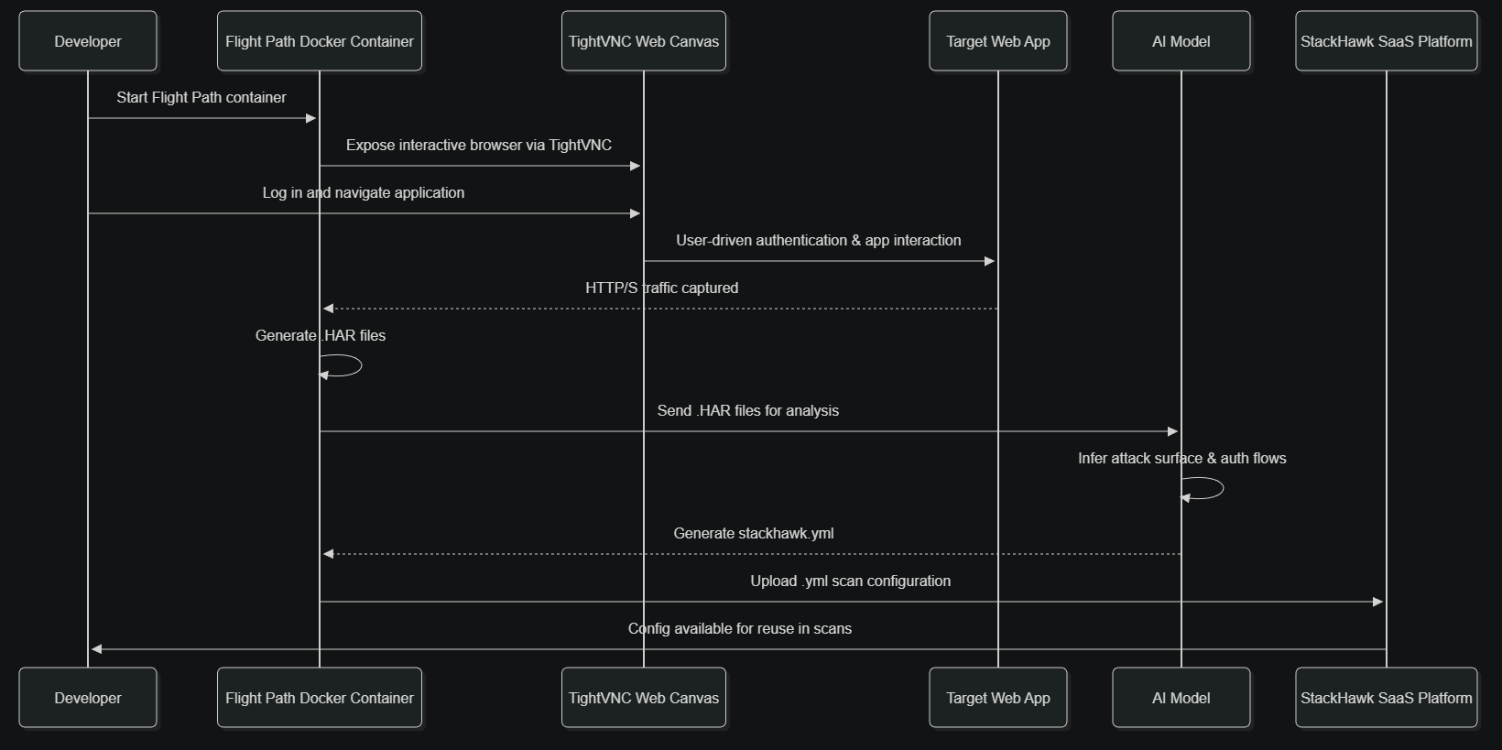
Okay, how do we use StackHawk? 2 – Flight Path
What is “Flight Path”?
  TL;DR: It auto-configs your StackHawk YML files. All we need to do is login and browse the web application.
  No need to re-describe your auth flow anymore!
  Limitation: Only works for external apps. It is highly likely the StackHawk team will add a proxy feature that allows it to scan internal apps. Dev POV: Login, browse app, get YAML config, scan app with authentication.

Slide 8
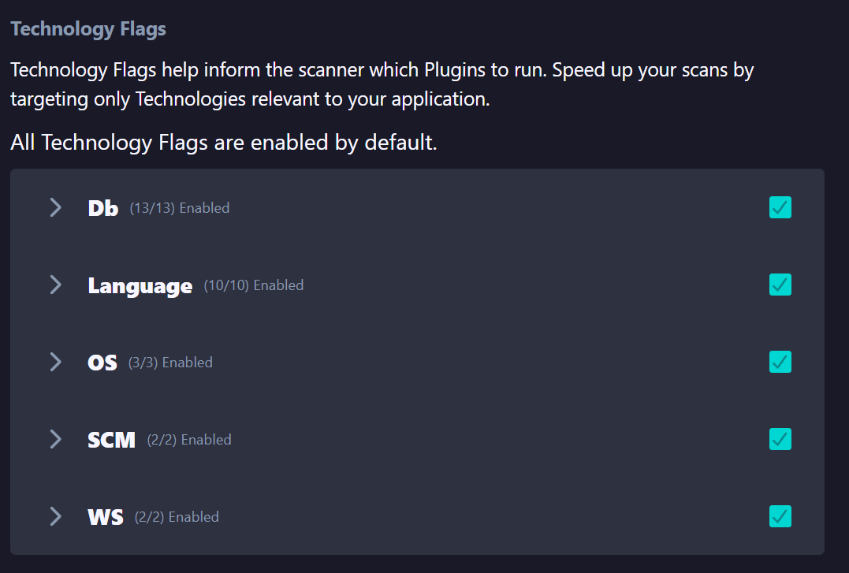
What about noise? False Positives?
False positives exist in StackHawk. This is the reason I have office hours every Tuesday and Thursday!
In addition to this, “Technology Flags” can be set on StackHawk per-app to tune the scanner.
I have very detailed guidance about False Positives here as well:
  https://bayview0.sharepoint.com/sites/ApplicationSecurity/SitePages/Wiz-Dev-Quick-Start-Guide.aspx#what-about-incorrect-detections-or-unfixable-issues
It is likely we can correlate findings between Wiz (a far less noisy SAST/SCA/IaC/Secrets/Cloud scanner) and StackHawk.
  Previously when we used Snyk (we have now switched to Wiz), we had an integration with StackHawk. It is likely we will see a Wiz integration.

Slide 9
AI Tool Use
Good news for AI coding tool users: StackHawk has agentic tooling available. It provides 2 Tools:
  “HawkScan” – Run DAST scans and view results.
  “API” – query the StackHawk API
This means that you can run StackHawk scans by simply asking an LLM to “Please run a StackHawk scan.”
  No need for long CLI arguments or manually editing YAML files!
We currently have a demo of this with the vendor – if you’d like to be included, please ping Henry Post on MS Teams.
  Guillermo Otero and myself, and the vendor (Scott G, Joni) were able to use an Agent Skills (or “Cursor Rules”) from StackHawk to automate the creation and onboarding of a frontend and backend with Cursor editor and StackHawk, as well as start running scans.
Full setup guide: https://docs.stackhawk.com/ai-security/agentic-dast-guide/
Agent Skills overview: https://docs.stackhawk.com/ai-security/agent-skills/
GitHub: https://github.com/stackhawk/agent-skills
See also: https://docs.stackhawk.com/ai-security/

Slide 10
FAQ and Questions
When do we run StackHawk scans in CICD?
  It depends. Some teams don’t have CICD integrations and I run a periodic job weekly that scans 50 of our internal apps.
  Ideally, it’d be post-dev-deploy, and then once per environment (DEV/UAT/PROD)
Can my team use StackHawk?
  Yes, if you have an app with an HTTP endpoint, it can! I recommend it.
How long do scans take?
  Scans can take between 10 minutes to an hour, depending on the complexity of your app, so I recommend running them as an async job with no upstream dependent jobs in CICD, so that releases don’t get blocked.
Why StackHawk? Why not another DAST tool?
  One of the biggest strengths of StackHawk is its declarative YAML language, meaning that all scans are highly automatable and scanning 50 apps in one go requires relatively little manual setup, other than setting up the auth flow, but Flight Path takes care of that.
<Please feel free to ask a question>

